Slide 1

UNIVERSITI TEKNOLOGI MALAYSIA
NAME : Alexander Tan Ka Jin
MATRIC : MCS241002
PROJECT : Project 1
PROJECT TITLE: Sentiment Analysis of news articles using Bidirectional Recurrent Neural Networks

Slide 2
INTRODUCTION

Slide 3
PROBLEM BACKGROUND
Sentiment Analysis is often done in short opinionated sentences.
Popular data for performing Sentiment Analysis:
IMDb Reviews
Twitter Tweets
There is a research gap for longer, less opinionated forms of text like news media.
Deep Learning models have been employed for Sentiment Analysis to great success. (Wankhade et al, 2022)

Slide 4
PROBLEM BACKGROUND
News can be biased, journalism does not always conform to objective facts
Types of biases within news media: (Rodrigo-Gines et al, 2024)
Spin : Sensationalistic coverage of news
Ideology : Bias introduced by author’s viewpoints
Coverage : The method and importance of news being covered
Gatekeeping: The type of news and sources being shown
Statement : How news portrays subjects
These biases can greatly affect how current events are portrayed and what actions must be done.

Slide 5
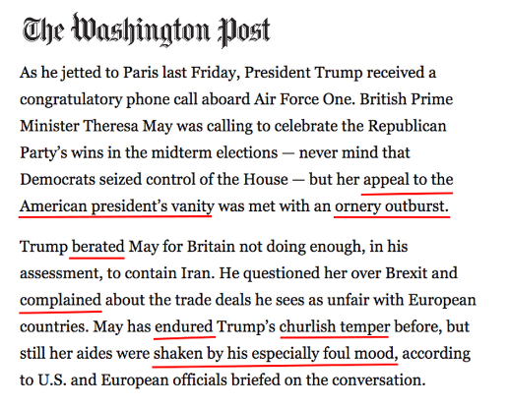
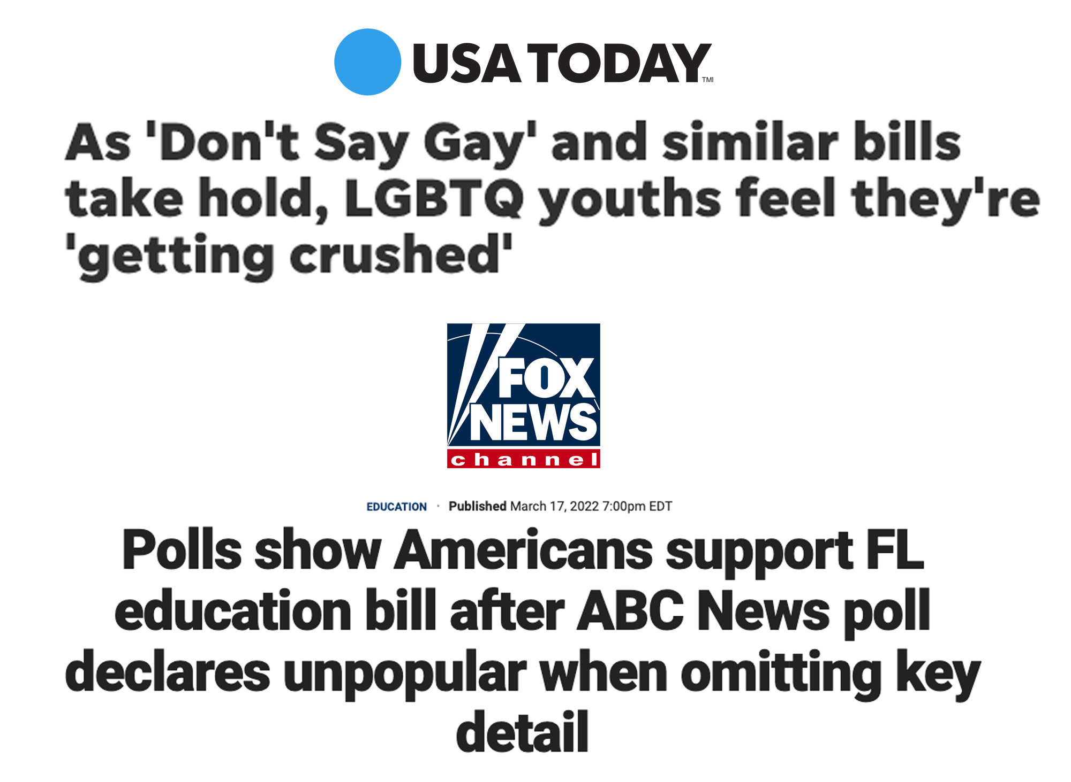
Some examples from US news: (Images from AllSides, accessed 2025)
Spin Bias:
Ideological Bias:

Slide 6

Some examples from US news:
Coverage Bias: (Fox News Website, Accessed 2:40PM 14/1/2025)

Slide 7
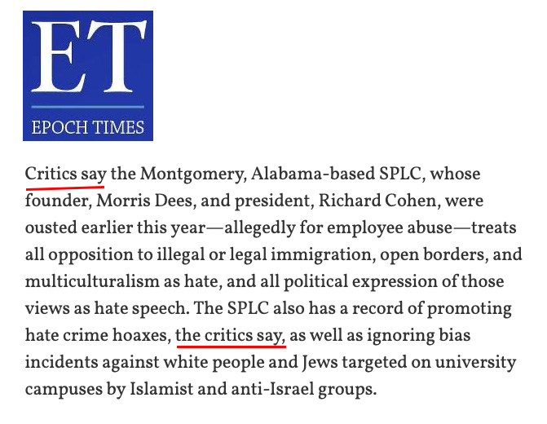
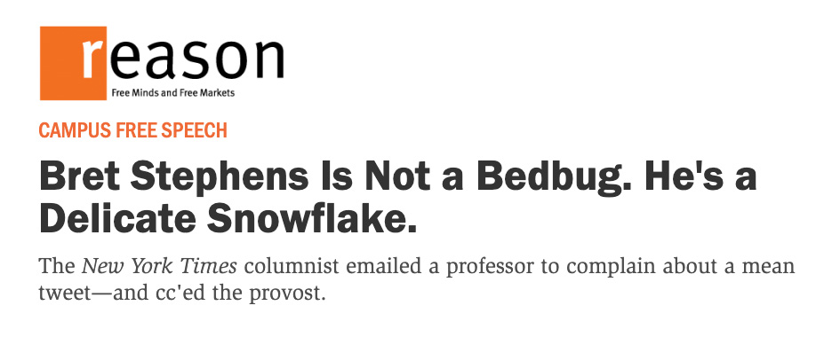
Some examples from US news: (Images from AllSides, accessed 2025)
Gatekeeping Bias:
Statement Bias:

Slide 8
PROBLEM STATEMENT
Deep Learning has been employed to great success in short-form Sentiment Analysis, but there needs research on corpuses with longer-forms of text.
Identify the extent Deep Learning Sentiment Analysis can perform:
Media Bias Identification
Long-form textual analysis

Slide 9
Research Questions / Objectives
QUESTIONS
OBJECTIVES
What is the efficacy of Deep Learning compared to previous long-form sentiment analysis methods?
Can Deep Learning Sentiment Analysis account for media bias/propaganda tactics?
Can we correlate Sentiment Scores with media bias?
Perform EDA on large news datasets to identify patterns and trends in the language use of journalism.
Construct BiLSTM and BiGRU models to uncover complex language patterns.
Conduct comprehensive evaluation on the model to ensure it's performance.
Visualize article sentiment by each media outlet.

Slide 10
SCOPE OF THE STUDY
The data used would ideally contain a large and diverse variety of news media outlets with a diverse set of biases.
This data will be meticulously cleaned and prepared for training of BiLSTM and BiGRU models.
The model will be evaluated for its performance using classifier evaluation techniques like Confusion Matrices.
Results will be visualized in graphs.

Slide 11
LITERATURE REVIEW

Slide 12
Scope of Literature Review
Deep Learning
Sentiment Analysis
News Media Biases
The history of Machine Learning
Natural Language Processing
Differences between Deep Learning and Machine Learning
Bidirectional Recursive Neural Networks (BiRNN)
Sentiment Analysis Techniques
Rules-based Sentiment Analysis
Word Embedding methods
Deep Learning approaches
Challenges of Sentiment Analysis
Types of Biases in News Media
Challenges to performing Sentiment Analysis in News Media

Slide 13
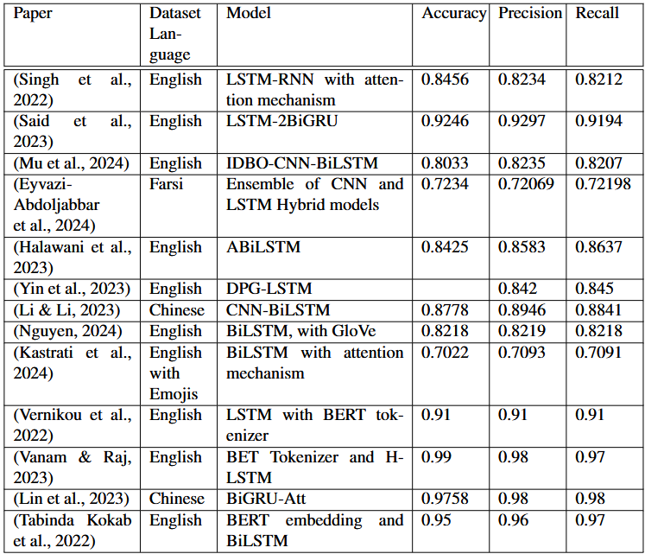
Literature Review

Slide 14
METHODOLOGY

Slide 15
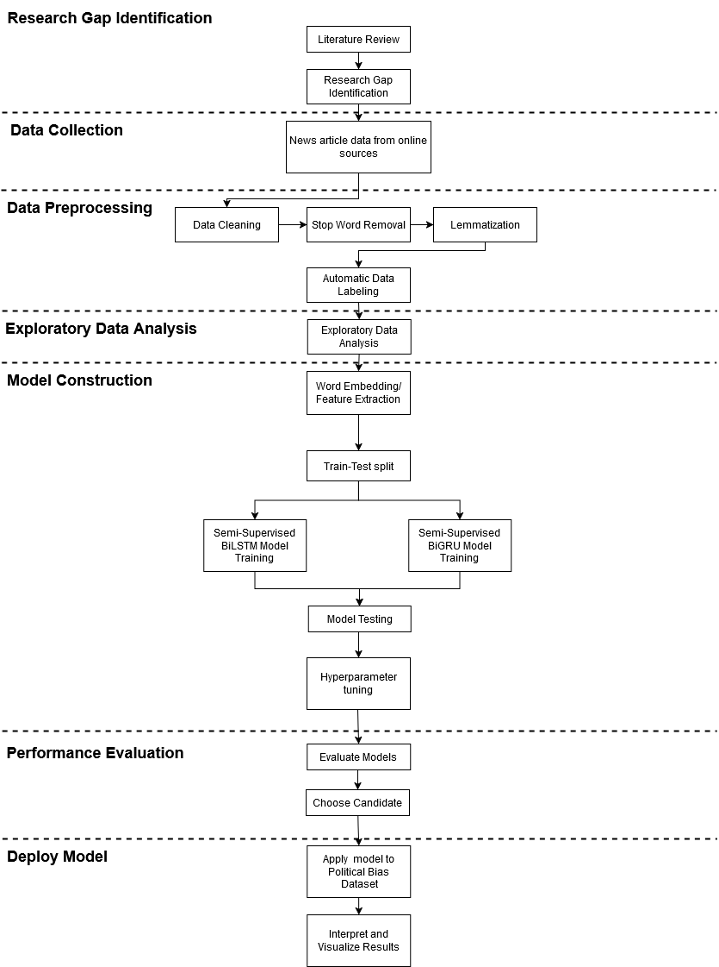
Research Framework

Slide 16

Data Source
AllTheNews 2.0 contains 2.6 million articles at a file size of 8.15 GBs
Non-commercial dataset for research purposes
Data was scraped using a python script
Contains articles from all sorts of media outlets
Includes all types of news including political, tabloids, entertainment and tech
Contains 26 news outlets
Political news coverage by 14 news outlets
https://components.one/datasets/all-the-news-2-news-articles-dataset/

Slide 17
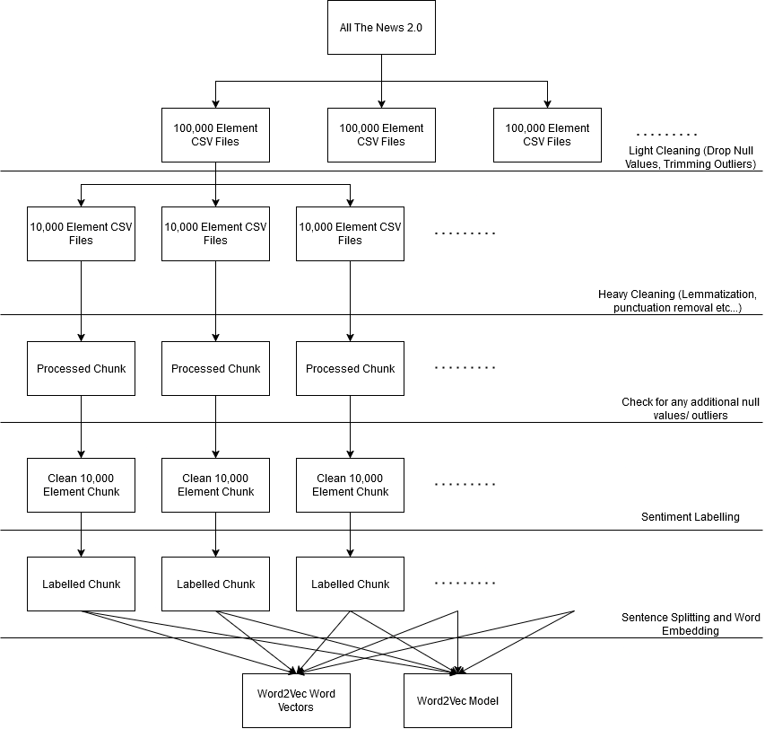
Data Cleaning

Slide 18
Data Cleaning
The following data cleaning techniques are applied:
Removing null articles/publications
Removing articles that are too short
Filtering for relevant publications (Non tabloid, entertainment/tech outlets)
Removing text elements (Punctuations, non-ascii characters,…)
Removing stop words
Lemmatization
Split into sentences
Remove null sentences

Slide 19
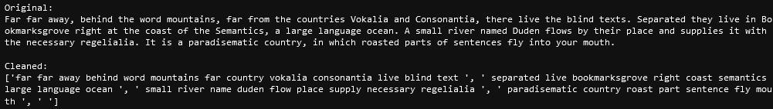
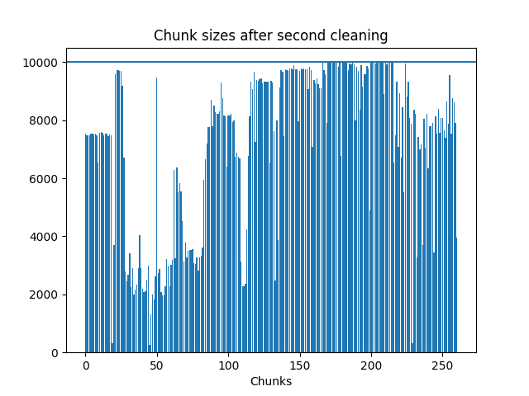
Data Cleaning Results
815,963 articles were removed
30.345% of the data

Slide 20

Sentiment Labelling
Sentiment Labelling was performed on all data for EDA
Using TextBlob
Scores are divided into:
Polarity [-1,1]
-1 is negative
0 is neutral
1 is positive
Subjectivity [0,1]
0 is objective
1 is subjective

Slide 21

Media Bias Labelling
Using AllSides media bias score
Labelled on a per publication basis

Slide 22
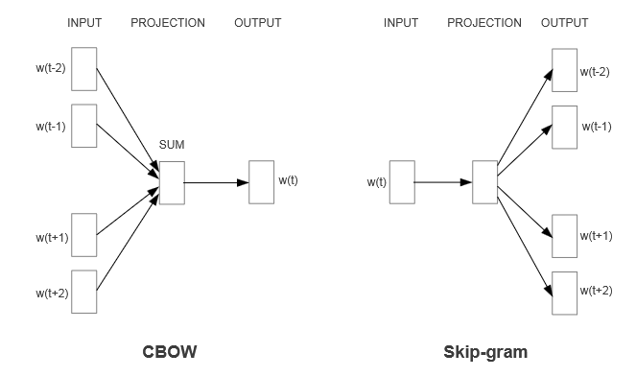
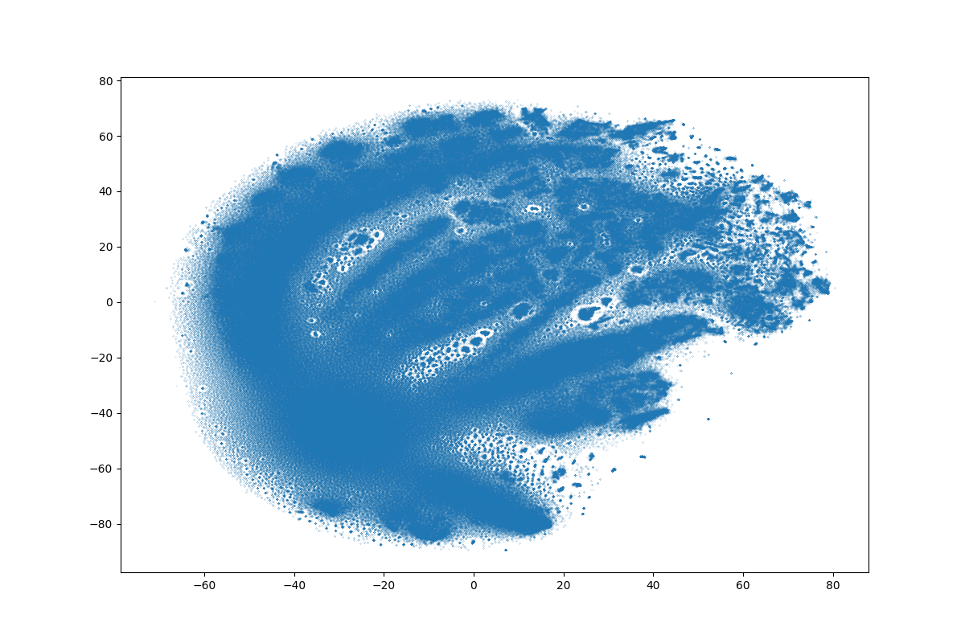
Word Vector Embedding
(Mikolov, 2013)
Data is embedded using Word2Vec, a simple unsupervised model for clustering words.
Using GenSim, a Word2Vec model was trained using the data
Model Hyperparameters:
Vector Size = 300
Window Size = 5
Min word count = 1
Epochs = 1
The embeddings are visualized with t-distributed stochastic neighbor embedding

Slide 23
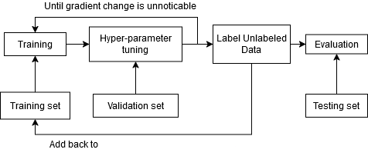
Model Training
Uses semi-supervised training
A portion of the data uses labels by TextBlob
The rest are labelled by the model through Pseudo-labelling
Evaluation uses criteria for classifier models:
Accuracy
Precision
Recall
Confusion Matrices
True Positives | False Negatives
False Positives | True Negatives

Slide 24
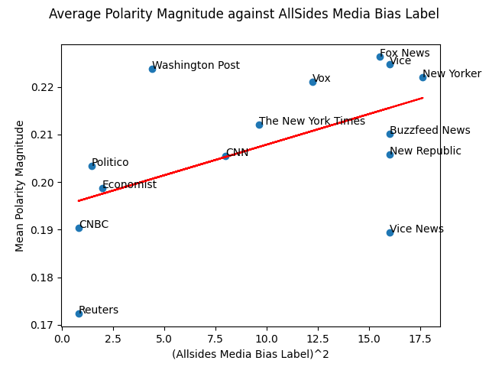
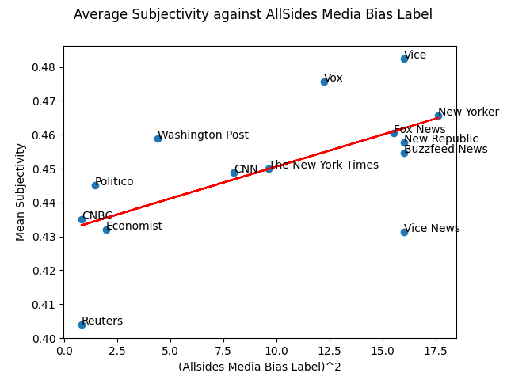
Initial Findings

Slide 25
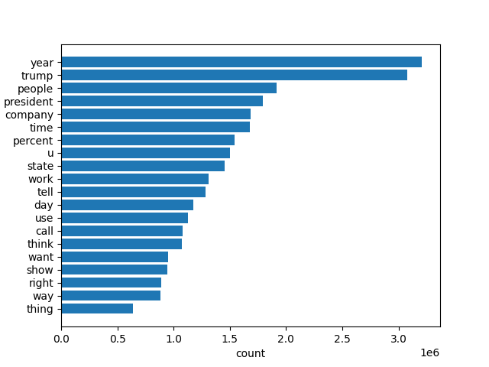
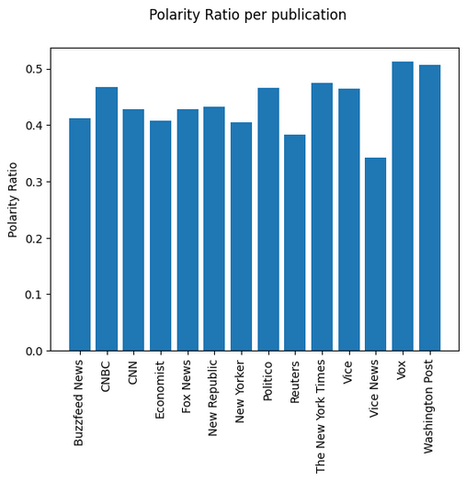
Initial Findings

Slide 26


Thank You.
utmofficial
univteknologimalaysia
utm.my

